Slide 1
Using data.census.gov

Slide 2
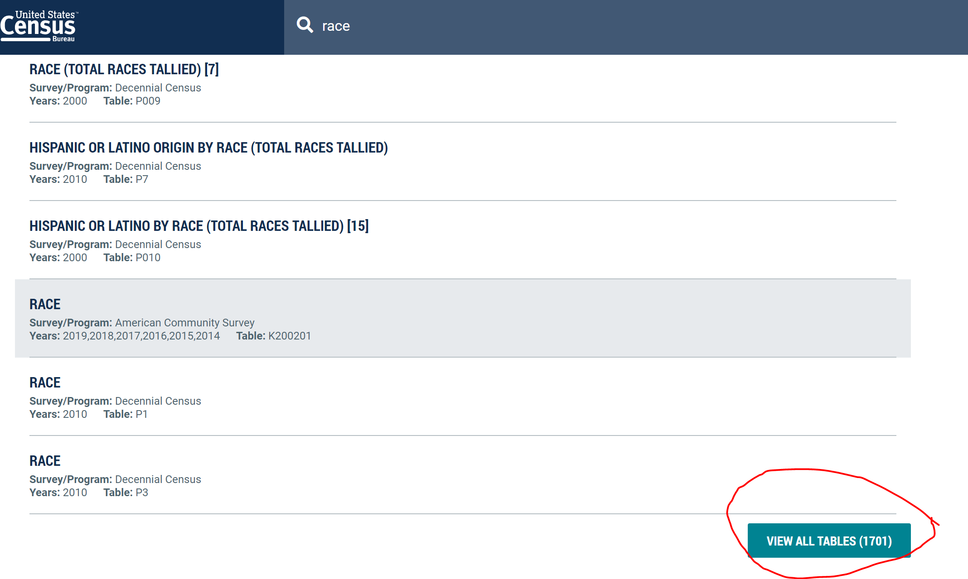
Find relevant data tables
In the search bar on the home page, enter a term of interest to you. I searched "race", which brought me to this page of data tables (pictured right) with not much detail about what they contain. If you scroll down and click "VIEW ALL TABLES", you'll be brought to a page where you can click between detailed views of the tables.

Slide 3
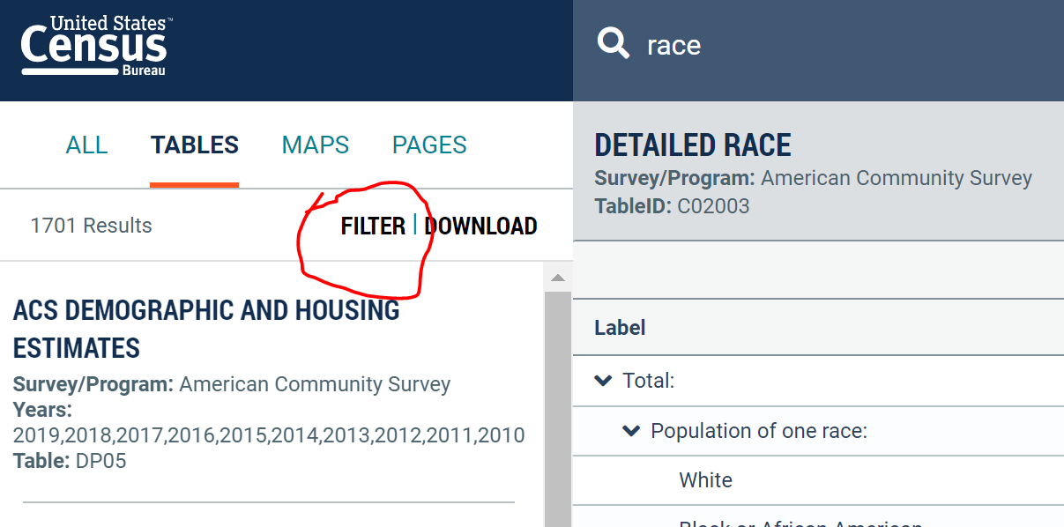
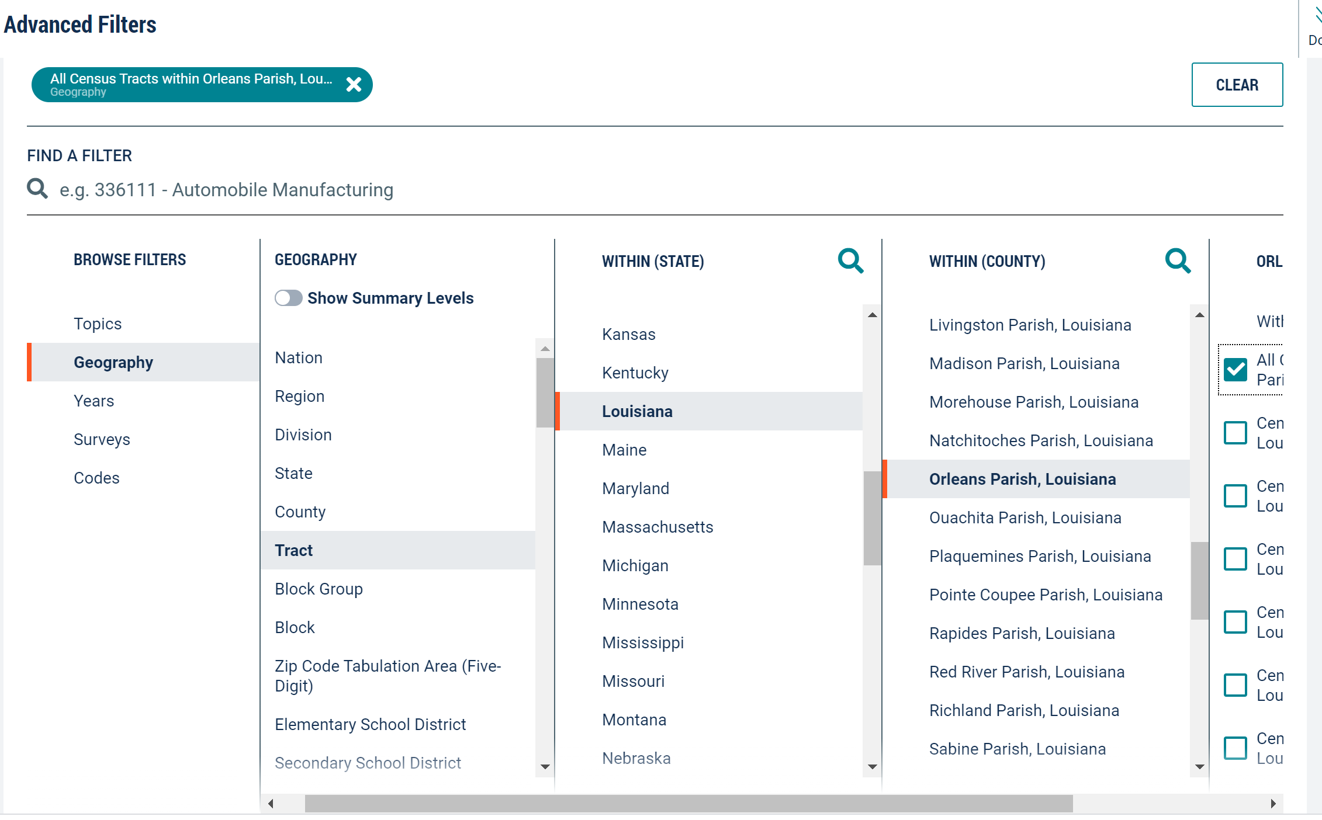
Select your geographies
In the upper-left corner of this page, click "filter" to select your geographies.
In the pop-up, select Geography > Tract > Louisiana > Orleans Parish > All tracts in Orleans Parish (or whatever specific tracts you may have identified to study).
Click "DONE" in the top-right corner of this pop-up to hide it.
New Orleans and Orleans Parish are the exact same geography – Orleans Parish is New Orleans and New Orleans is Orleans Parish.

Slide 4
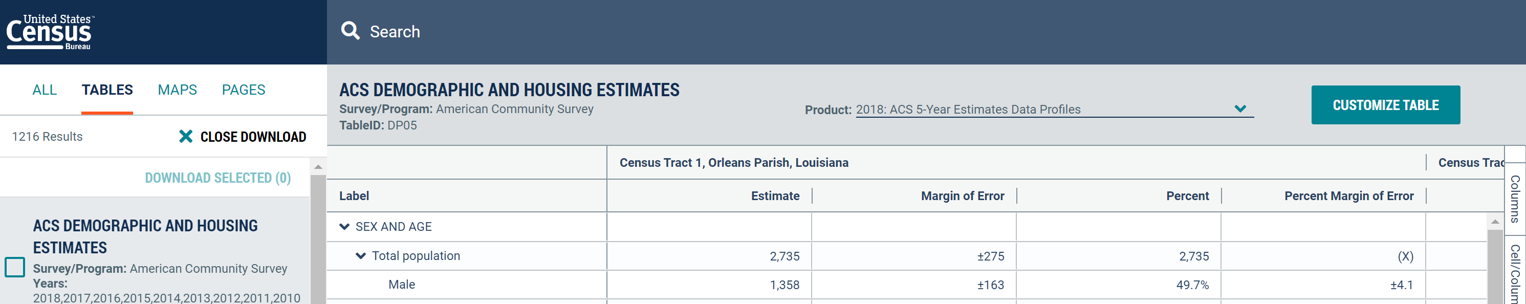
Data product/year + downloading
The "product" dropdown underlined below lets you select which survey or resource you'd like to get your data from. Most tract-level data will come from 5-year averages of ACS data, and this is the product we recommend using. This dropdown is also where you'll select the year you want the data to be from.
To download the data, click "CUSTOMIZE TABLE"

Slide 5
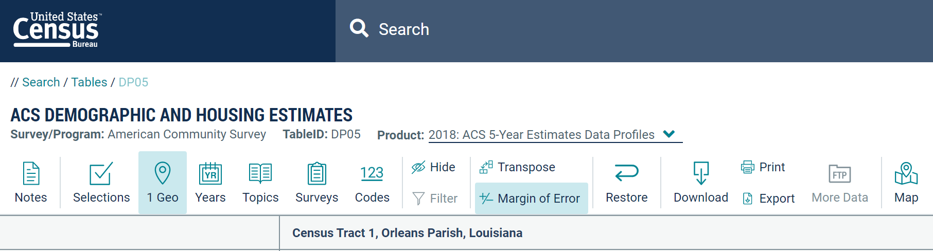
Edit your selection
From this page, you can change your geographies and dates, look at a map of the data, and download the data as a spreadsheet.

